Slide 1

Expense Management System
Team Members
Mayur Uparikar
Shaikh Aseen
Kiruthika B.
Project Mentor
Mr. Suramya Biswas Sir

Slide 2
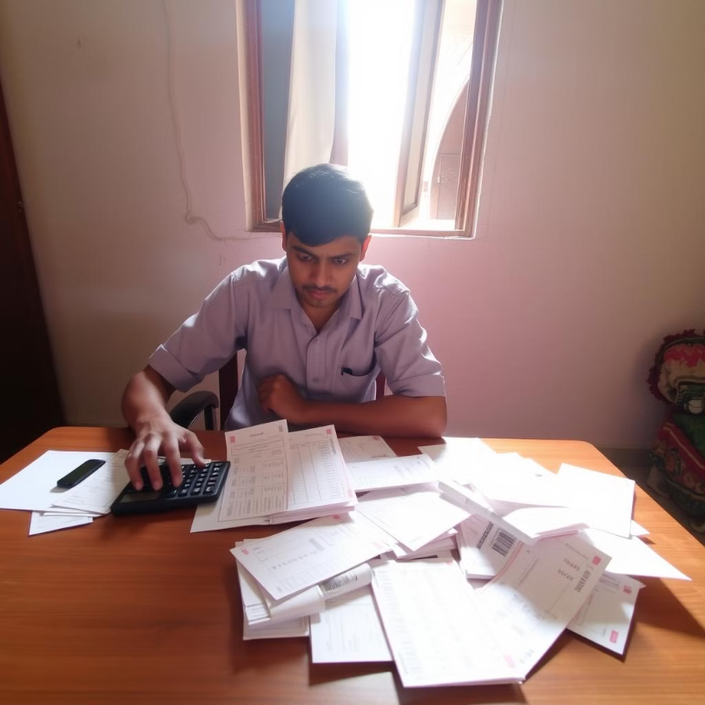
Introduction
An intuitive expense management system designed to help middle-class users track spending, set budgets, and maintain financial control effortlessly.

Slide 3

Project Overview
Efficiency
Time-Saving
Ensures efficiency and transparency.
Eliminates manual tracking.
Budgeting
Aids in budget planning and analysis.

Slide 4
Key System Modules
User Module
Expense Module
Category Module
Report Module
Registration
Add Expenses
Categorize Expenses
Generate Reports
Authentication
Update Expenses
Track Spending
Dashboard Access
Manage Expenses

Slide 5
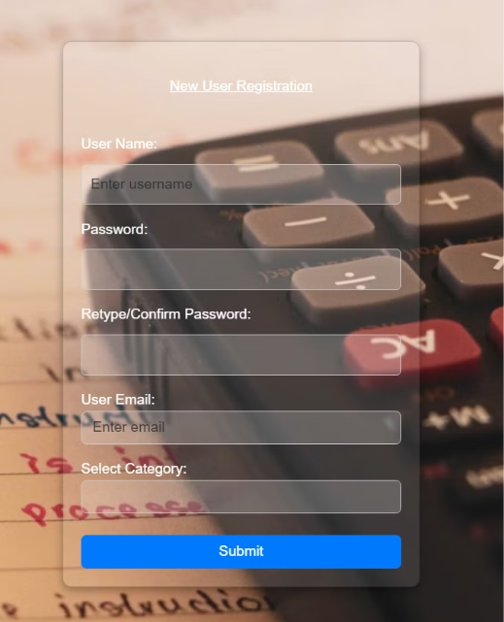
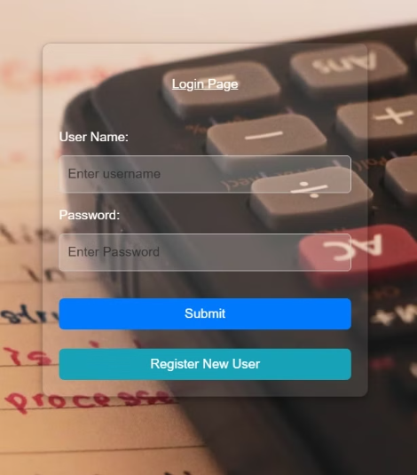
Output
Login Page
Registration Page

Slide 6
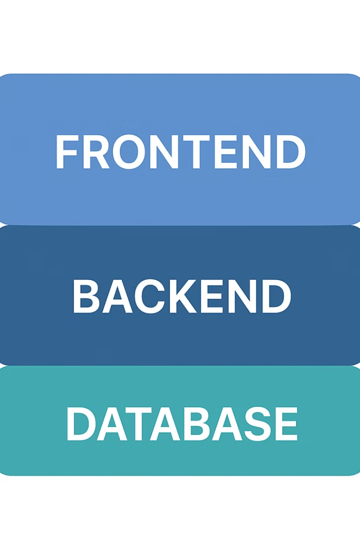



Technologies
Backend
Java, Spring Boot, Spring JPA
Frontend
React.js, Bootstrap, Chart.js
Database
MySQL
Security
Spring Security
Tools and Technologies
Eclipse IDE, Visual Studio Code, MYSQL Workbench

Slide 7

Future Enhancements
Smart Financial Management: AI integration will enable analysis of spending patterns and provide personalized budget suggestions, along with automation of recurring expenses for improved efficiency.
Enhanced Tracking and Collaboration: Multi-currency support, bank account integration, expense sharing, and bill splitting features will streamline financial tracking and make managing group expenses more convenient.
Accessibility and Data Security: A mobile app version will offer users on-the-go access, while cloud backup will ensure secure and reliable storage of financial data.

Slide 8

Conclusion
The Expense Management System provides an efficient way to track and manage daily expenses. It helps users maintain a clear record of their spending, set budgets, and analyze financial patterns. By simplifying expense tracking, it promotes better financial planning and control.

Slide 9
THANK YOU

